Slide 1
Meeting of Reinsurance Officials (MORO) 2023, ICMIF Innovation and InsurTech Andrew Johnston
June 2023

Slide 2
State of InsurTech
Current landscape

Slide 3
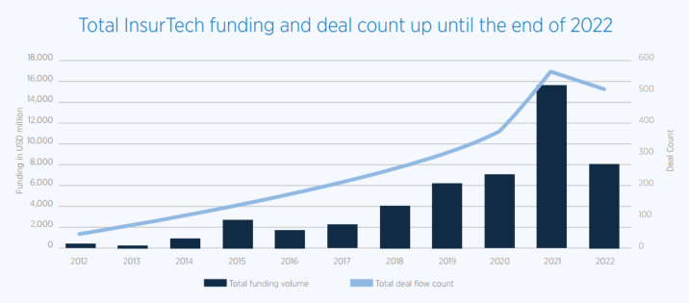
Global InsurTech Funding
$50+ billion invested into InsurTech over the past decade

Slide 4
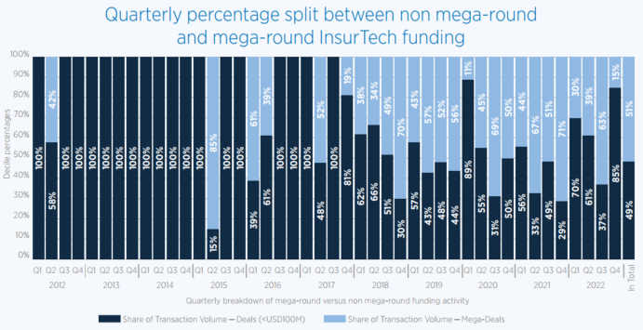
Impact of mega-round funding

Slide 5
2023 Q1 – Most recent round of funding

Slide 6
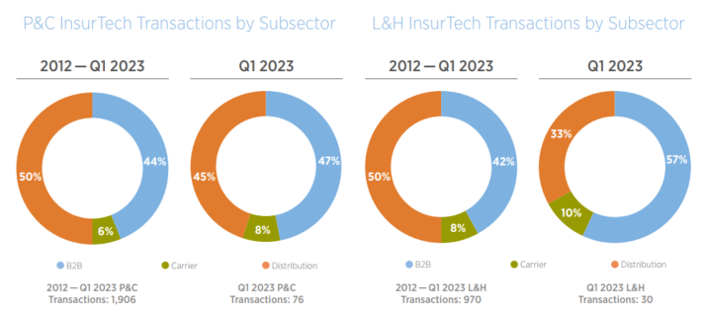
Current breakdown of funding

Slide 7
Current and Emerging Trends/themes

Slide 8
2023 Trends and beyond
3 distinctive InsurTech business models
Distribution – Embedded insurance and utilization of brokers/agents (digitally)
B2B – Back office support through remote servers and modular tools
Risk origination – better defined products with co-piloted bionic underwriting

Slide 9
Advantages for Mutual Insurance companies

Slide 10
Mutuals – the competitive advantage
Why InsurTech is a great fit
Technology – it is expensive, and the road is long. Companies with longer term
ambitions and consistent leadership typically do better
Know your audience – Mutuals have a much better appreciation for their
consumer market. The consumer group is arguably more homogeneous and
solutions can be better tailored. Mutual consumers enjoy transparency and will
appreciate the desire to be more efficient and cost effective
Financing model– many InsurTechs have set themselves up as neo-mutuals who
are targeting a specific audience with a cost-effective model.

Slide 11
EMC’s digital journey – How an established player is making the most of InsurTech
Pavan Goteti, VP Innovation & Business Process Management, EMC Insurance Companies (USA)

Slide 12
Thank You!

